Slide 1
CRUD-project Presentation
TEAM -1 (07-11-2022)

Slide 2
Team Details Team Name: Rose Petals Team Leader: Sobin Soniya S Team Members: 4 1. Priya S D 2. Merlin Velsely A 3. Sahaya Sebastin lino C 4. Prabin Anto A M
Notes:
-Add team details with name and qualification,e-mail,phone no and place

Slide 3
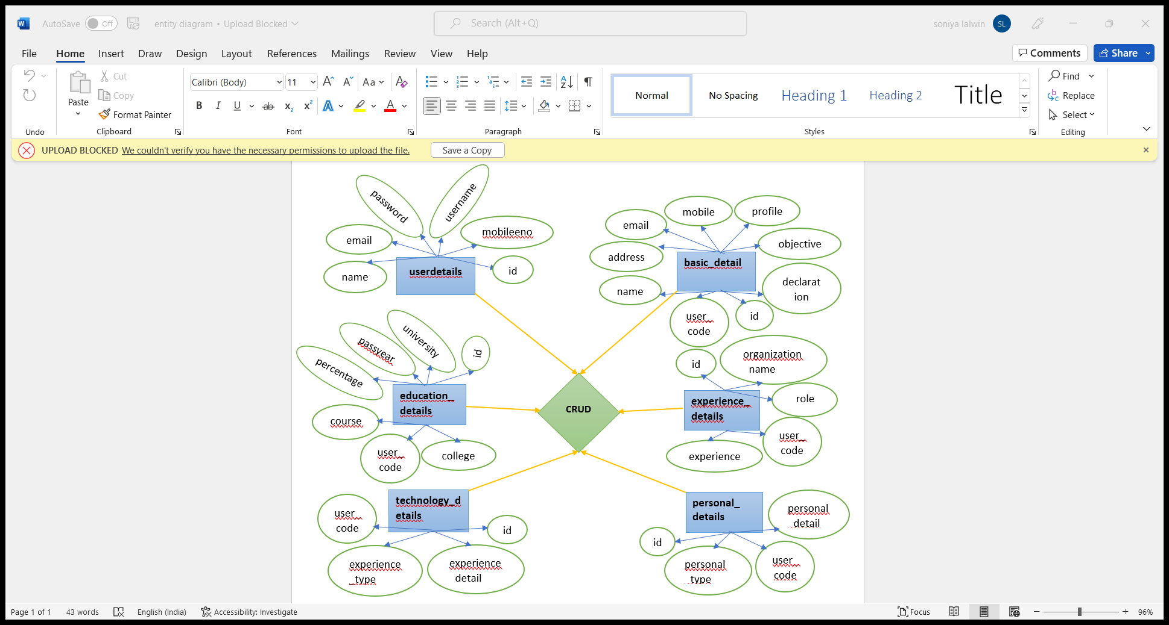
Database Design
Notes:
Get the database design from the phpmyadmin or from SRS document

Slide 4
Form Design
1. userdetails
2.basic_detail
3.education_details
4.experience_details
5.technology_details
6.personal_details
id | name | username | password | email | mobileeno
id | user_code | name | address | email | mobile | profile | objective | declaration
id | user_code | coursename | university | college | passyear | percentage
id | user_code | organization_name | experience | role
id | user_code | experience_type | experience_detail
id | user_code | personal_type | personal_detail
Notes:
Get the form design from the phpmyadmin or from SRS document

Slide 5
Sample Source code
<form method="post" >
<table class="table table-striped table-bordered table-hover">
<tr>
<td align="right"><b>Name</b></td>
<td>
<input type="text" name="name" id="name" class="form-control" value="
<?php if($action=="edit"){ echo $data['name'];}else {echo "";} ?>"
placeholder="Name" required="required" autofocus="autofocus">
</td>
</tr>
<tr>
<td align="right"><b>User Name</b></td>
<td>
<input type="text" name="username" class="form-control" value="<?php if($action=="edit"){echo $data['username'];}else{echo "";} ?>" required="required">
</td>
</tr>
</table>
</form>

Slide 6
TEAM MEMBER -1
1. Priya S D
2. Merlin Velsely A

Slide 7
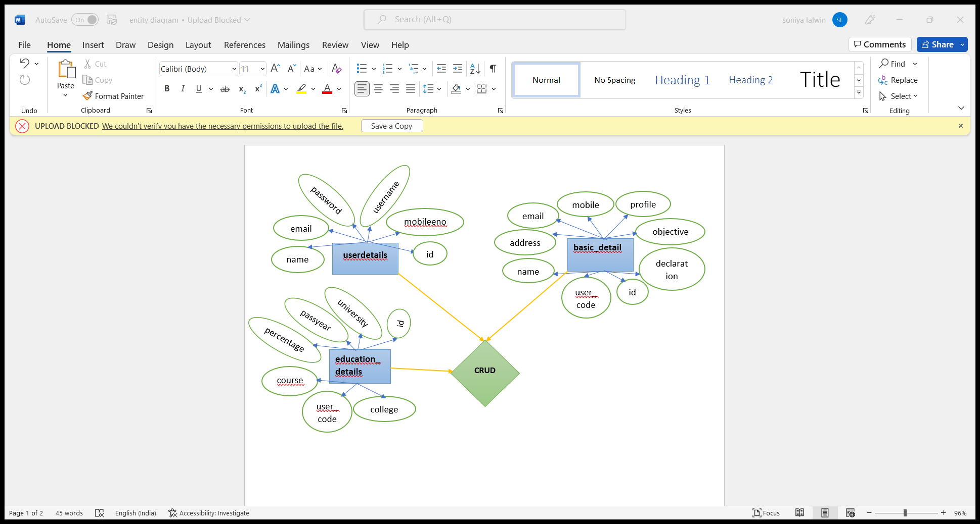
Forms & Database Design
Notes:
Explain Form and database worked with

Slide 8
1.userdetails
id | name | email | Password | username | Mobileno
2.basic _details
id | user_code | name | address | email | Mobileeno | profile | objective | declaration
3.educational_details
Id | user_code | percentage | Pass year | coursename | university

Slide 9
Problem/difficulty Faced
Insert and Edit actions are not worked in the browser.
Notes:
Explain problem faced

Slide 10
Solution to the problem
Some details were missed in the code.
Notes:
Explain how attained the solution

Slide 11
Sample Source code for update action
if(isset($_REQUEST['edit'])){
$user_code = $_REQUEST['user_code'];
$coursename = $_REQUEST['coursename'];
$university = $_REQUEST['university'];
$college = $_REQUEST['college'];
$passyear = $_REQUEST['passyear'];
$percentage = $_REQUEST['percentage'];
$query = "UPDATE `education_details` SET `user_code`='$user_code',`coursename`='$coursename',`university`='$university',`college`='$college',`passyear`='$passyear',`percentage`='$percentage', WHERE id='$id'";
$message=iud_data($query);
if($message=="sucess"){
echo"<script>alert('data saved successfully ')</script>";
echo"<script>window.location='education_details.php'</script>";
}else{
echo"failed ".mysql_error();
}
}
Notes:
Explain how attained the solution

Slide 12
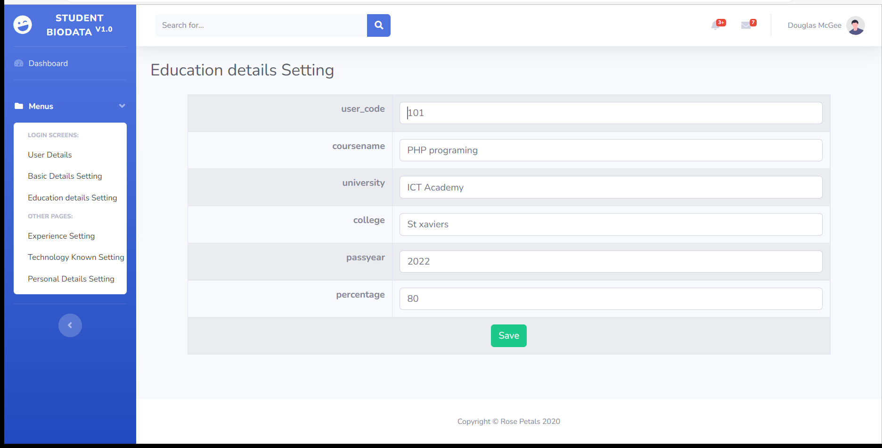
Sample Output of Update action

Slide 13
TEAM MEMBER -2
1. Sahaya Sebastin Lino C
2. Prabin Anto A M

Slide 14
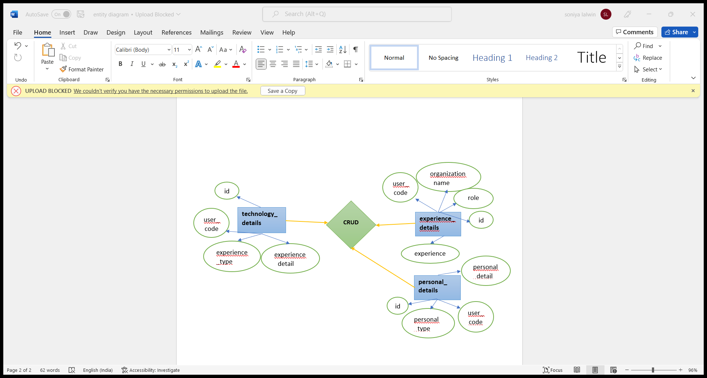
Forms & Database Design
role

Slide 15
4.experience_details
id | role | usercode | organization | experience
5.technology_details
Id | usercode | experience_type | Experience_details
6.personal_details
id | Personal type | User code | Personal detail

Slide 16
Problem/difficulty Faced
The users details are not displayed in the browser.

Slide 17
Solution to the problem
The project name and the database name are different. It was worked, once we gave the same name for the project and the database.

Slide 18
Sample Source code for delete action
if($action == 'delete'){
$id = $_REQUEST['id'];
$query = "delete from basic_detail where id='$id'";
$message=iud_data($query);
if($message=="sucess"){
echo"<script>alert('data deleted successfully ')</script>";
echo"<script>window.location='basic_details.php'</script>";
}else{
echo"<script>alert('failed to delete')</script>";
}
}
Notes:
Explain how attained the solution

Slide 19
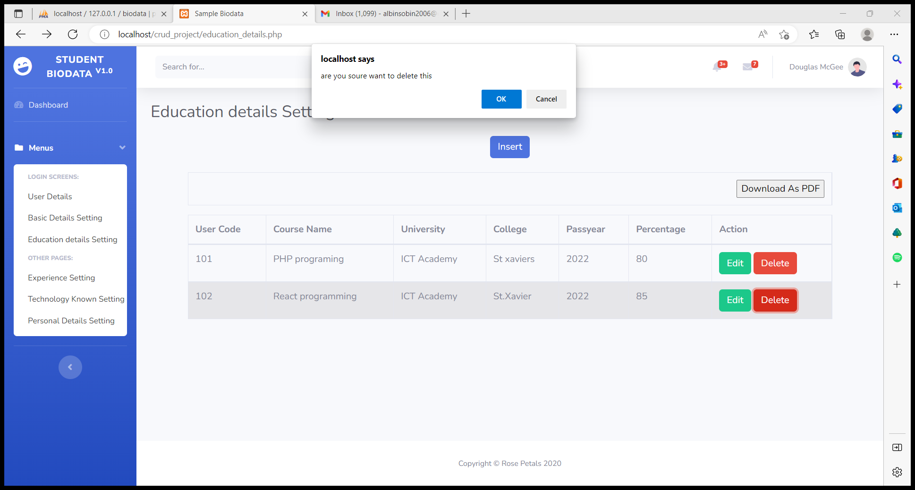
Sample Output of Delete action

Slide 20
Thank You

